Slide 1
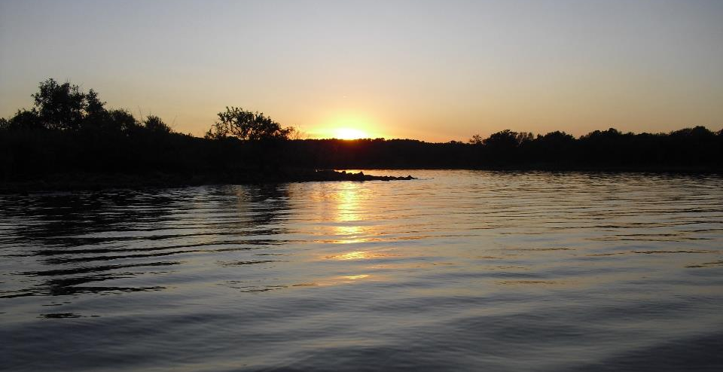
MCM-3 and Part IV Inspection and Sampling Requirements
GCSA Workshop
OKR04 MCM-3 and Part IV Sampling and Field Methods
Presented by INCOG
Nienhuis Park
May 18, 2022

Slide 2


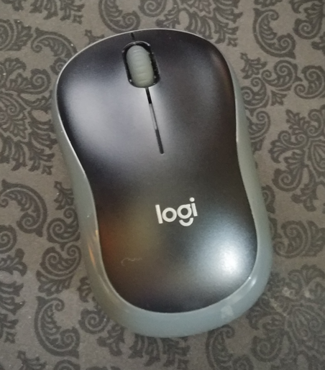
INCOG’s GCSA Program Staff Changes
Now what ??
Out With the “Old”:
Richard retires June 30th
Vernon retires July 31st to part-time status
In With the “New”: (starting ~August 1st)
INCOG will hire a new WQ staff person
Vernon will be part-time support for GCSA
Short-term timelines uncertain now

Slide 3

GCSA FY22-23 Program Changes
FUTURE GOALS FOR GCSA:
  As smooth a transition as possible.
  No major changes to INCOG’s GCSA Scope of Services.
  Continue Tech Outputs: docs, meetings, etc.
INTERIM TRANSITION GOALS:
  Will take time for “new” staff to acclimate.
  High priority activities will not be interrupted.
    303(d), TMDLs, sampling and inspections issues.
    Documents: QAPPs, SOPs, written guidance, SWMPs, ARs.

Slide 4
Overview of Relevant OKR04 Sections
Most OKR04 “monitoring” and “sampling” (M&S) passages discuss these generally (i.e., mentioned, but no procedures). The most important are:
  Part IV.A [303(d)]
  Part IV.B (TMDLs)
  Part V.C.3 (MCM-3)
  Part VI.A (Monitoring)
  Part VI.C (Annual Reports)
Part IV.A [303(d)] requires setting priority areas and inspecting for 303(d) pollutant sources (no procedures in OKR04).
Part IV.B (TMDLs) covers several types of monitoring (some details):
  TMDL Optional Baseline Monitoring Plan
  TMDL Monitoring Plan
  TMDL Monitoring Requirements

Slide 5
Overview of Relevant OKR04 Sections (cont.)
Part V.C.3 (MCM-3) discusses aspects of monitoring (no procedures in OKR04):
  Setting priority areas
  Mapping potential sources
  Conducting DWFS and IDDE inspections
Part VI.A (Monitoring) provides several important QA aspects of a monitoring program, including:
  Documentation and recordkeeping
  Representativeness in sampling
  40 CFR Part 136 laboratory methods
Part VI.C (ARs) has requirements for reporting sampling data and assessing programs using monitoring data (no procedures in OKR04).

Slide 6
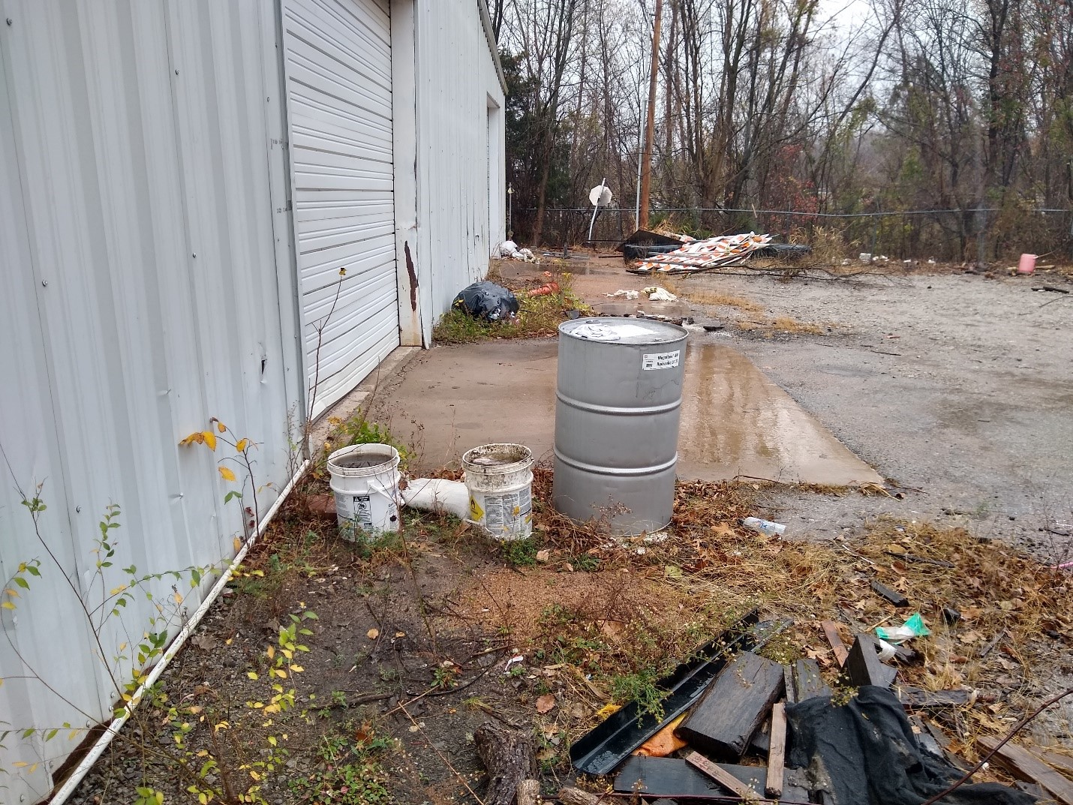
Part IV.A 303(d) M&S Requirements
Part IV.A.1 has 8 sub-parts (Items 1.a – 1.h) that must be addressed in the SWMP. Only items c and d have implied or specific inspection / sampling requirements:
  Concerns BMP implementation to address 303(d) POCs.
  Concerns education outreach.
  “You must identify any non-stormwater discharges that contribute significant pollutants to your impaired waters.”
  “You must locate those areas likely to have illicit discharges and conduct inspections based on the priority areas in [303(d)] …watershed.”
  Concerns O&M of structural and nonstructural stormwater controls.
  Concerns assessing new and existing flood management projects for water quality impacts.
  Concerns suggestions of how to find appropriate BMPs.
  Concerns implementing BMPs to address 303(d) bacteria POCs.

Slide 7
Part IV.A.1.c Identify Pollutant Discharges
“You must identify any non-stormwater discharges that contribute significant pollutants to your impaired waters.”
Does this require sampling, inspections or a monitoring program?
What is meant by “identify”? (Implies some type of analysis)
Sampling likely needed to confirm specific sources of “discharges”.
INCOG’s SWMP Template uses a land use assessment approach:
SWMP Table 10: List of Potential Significant 303(d) Pollutant Sources
303(d) Waterbody | 303(d) Pollutant | POC Source Type | Source Location / Description
Example 1 River | Enterococcus E. coli | Residential subdivision | Shady Hills. Completed 1980s. 120 RS-3 homes. Curb & gutters.
Example 1 River | Enterococcus E. coli | Cattle Ranch | 80 acres in SE part of MS4. 30+ cattle. Private.

Slide 8
Part IV.A.1.d Inspect For Illicit Discharges
“You must locate those areas likely to have illicit discharges and conduct inspections based on the priority areas in [303(d)] …watershed.”
This passage has three requirements bundled together:
  Locate illicit discharge areas
  Inspect for illicit discharges
  Establish priority areas for inspections
The SWMP Template refers to using the same inspection methods under Part V.C.3.a (MCM-3) which include:
  Dry Weather Field Screening (DWFS) and IDDE Source-Tracking inspections.
Part V.C.3.a also requires using priority areas for increased DWFS inspection frequencies.
That is, what works for MCM-3 inspections will also work for 303(d) inspections.

Slide 9
Part IV.B TMDL M&S Requirements
OKR04 Part IV.B lists 8 “Table IV-2 MS4” obligations. Only items 3, 4 and 5 have specific monitoring requirements:
  SWMP review and modification
  TMDL Pollutant Reduction Plan
  TMDL Pollutant Monitoring Plan
  TMDL Baseline Monitoring Plan (optional)
  Monitoring requirements (including QAPP)
  Annual TMDL Implementation Report
  TMDL implementation schedule (Table IV-1)
  Existing approved TMDLs (Table IV-2)

Slide 10
Part IV.B TMDL Implementation Schedule
OKR04 Part IV.B.7 Table IV-2 is a TMDL implementation schedule:
TMDL Activity | Option A (no Baseline Plan) | Option B (Baseline Plan)
SWMP review and evaluation | No more than two years from TMDL effective date
TMDL Pollutant Baseline Monitoring Plan | n/a | No more than three years from TMDL effective date
TMDL Pollutant Reduction Plan | No more than three years from TMDL effective date | No more than 5 years after implementation of the baseline monitoring plan
TMDL Pollutant Monitoring Plan | No more than three years from TMDL effective date | No more than 5 years after implementation of the baseline monitoring plan
TMDL Effective Date: June 1, 2022

Slide 11
Part IV.B.3 TMDL Pollutant Monitoring Plan
“Your MS4 shall participate in a coordinated regional pollutant monitoring plan or develop their own individual plan. The plan should be designed to establish the effectiveness of the selected BMPs and demonstrate progress toward achieving the reduction goals of the TMDLs or watershed plans, and eventual attainment of water quality standards “
Clearly requires sampling under a monitoring plan.
The Monitoring Plan can be developed by each MS4, or MS4s can join a regional plan.
OKR04 provides no details about conducting monitoring.
The SWMP Template defers to DEQ’s forthcoming TMDL monitoring guidance.

Slide 12
Part IV.B.4 TMDL Baseline Monitoring Plan
“Your MS4 may participate in a coordinated regional baseline monitoring plan or develop their own individual plan. The plan should be designed to determine the existing levels of POCs in your MS4’s discharge(s) and identify high priority areas which may benefit from targeted BMPs.”
Clearly requires sampling under a monitoring plan.
However, Part IV.C.B.4 baseline monitoring is optional.
The Baseline Monitoring Plan can be developed by each MS4, or MS4s can join a regional plan.
OKR04 provides no details about conducting monitoring.
The SWMP Template defers to DEQ’s forthcoming TMDL monitoring guidance.

Slide 13
Part IV.B.5 TMDL Monitoring Requirements
OKR04 lists several important requirements for monitoring plans:
“At a minimum, the monitoring plan(s) shall provide:
  a detailed description of the program goals, monitoring plan, and sampling and analytical methods,
  a list and map of the selected TMDL pollutant monitoring sites,
  the frequency of data collection to occur at each station or site,
  the parameters to be measured relevant to the TMDL(s), and
  the Quality Assurance Project Plan [QAPP] that complies with EPA requirements.⁶
⁶ EPA Requirements for Quality Assurance Project Plans (QA/R-5).”
The SWMP Template defers to DEQ’s forthcoming TMDL monitoring guidance.

Slide 14
Part V.C.3 MCM-3 M&S Requirements
Part V.C.3 has 8 sub-parts (Items i – viii) that must be addressed in the SWMP. Items i, ii, iv and v have implied or specific inspection / sampling requirements:
Identify priority areas having a likelihood of illicit discharges
Trace or investigate illicit discharge sources
Remove illicit discharge sources
Use visual indicators and simple field test kits for investigations
Conduct DWFS inspections at the frequency specified in OKR04 Table V-4
Adopt an ordinance or other mechanism to prohibit illicit discharges
Maintain a storm sewer system map showing outfalls and receiving waters
Maintain a list of OKR04 Part II.B.2 incidental non-stormwater discharges

Slide 15
Part V.C.3.i Priority Area Requirements
“Identify priority areas including areas with a higher likelihood of illicit connections or discharges (e.g., …). Update this priority area list to reflect changing priorities annually.”
MCM-3 now requires developing Priority Areas for the IDDE program.
The “list” of priority areas must be updated annually.
Part V.C.3.i lists a number of examples of potential sources of illicit discharges useful for defining priority areas.
The SWMP Template provides detailed criteria and procedures for setting and using MCM-3 priority areas.

Slide 16
Part V.C.3.ii Source Tracking Requirements
“Trace or investigate the source of an illicit discharge. The investigation shall take place within 72 hours of the receipt of any complaints, reports or monitoring information that indicates a potential illicit discharge.”
MCM-3 implies inspections and sampling under a monitoring program (“investigation”) as an integral part of the IDDE program.
The “investigation” of any potential illicit discharge must take place within 72 hours of when the report to the MS4 or discharge discovery is made.
Part V.C.3.i does not provide any detailed methods for conducting investigations (sampling parameters, inspection field notes, etc.).
The SWMP Template provides detailed criteria and procedures for conducting MCM-3 IDDE investigations.

Slide 17
Part V.C.3.iv IDDE Sampling Requirements
“Identify problems using visual indicators and simple field test kits. Laboratory methods can be reserved for situations where you have identified a problem and need to enforce on a suspected illicit discharger.”
OKR04 lists data collection requirements for performing IDDE investigations:
  Visual indicators
  Simple field test kits
  Laboratory analysis of samples
These requirements also apply generally to DWFS (visual and test kits).
Part V.C.3.iv does not provide specific tests or procedures for conducting investigations (parameters, visual inspection field notes, etc.).
The SWMP Template provides detailed criteria and procedures for conducting MCM-3 IDDE and DWFS investigations.

Slide 18
Part V.C.3.v DWFS Frequency Requirements
“At a minimum, DWFS shall be conducted at the frequency outlined in Table V-4 below.”
OKR04 Table V-4 lists required minimum DWFS inspection frequencies:
The SWMP Template defers to local SOPs and guidance for conducting MCM-3 DWFS investigations, with DWFS field forms in SWMP Appendix H.
Table V-4: MCM-3 Minimum Frequency of Dry Weather Field Screening
DWFS Areas | Category 1 | Category 2 | Category 3
DWFS At All Identified Outfalls | 20% per year ¹ | 40% per year ¹ | 40% per year ¹
DWFS At High Priority Areas | Once per year | Once per year | Once per year
¹ The number of outfalls screened shall be rounded up to the nearest integer

Slide 19
Part VI.A Monitoring Requirements
Part VI broadly covers “Monitoring, Recordkeeping and Reporting”.
  Part VI.A – Monitoring
  Part VI.B – Recordkeeping
  Part VI.C – Annual Reports
Part VI.A (Monitoring) has four subparts:
  Defines purposes of monitoring.
  Requires “Representativeness” and use of 40 CFR Part 136 lab methods.
  Requires specific types of recordkeeping for monitoring records.
  Refers to possible future use of electronic DMR reporting (eDMRs).
Part VI.A has OKR04’s most detailed requirements for conducting monitoring, but much is still left to local definition.

Slide 20
Part VI.C.1 AR Data Requirements
OKR04’s Annual Report requirements address data goals (purposes):
The content of the annual report shall provide all of the following information:
  Report the status of your compliance with permit conditions, including an assessment of the progress towards achieving the statutory goal of reducing the discharge of pollutants to the MEP.
  For each BMP identified in your SWMP, include an assessment of the
    progress made toward achieving each measurable goal, and
    appropriateness of the BMP.
  Report the results of information collected and analyzed, if any, during the reporting period, including monitoring data used to assess the success of the SWMP at reducing the discharge of pollutants to the MEP.

Slide 21



Questions ?
Vernon Seaman
Manager, Envir. And Energy Planning
INCOG
Two West 2nd Street, Ste 800
Tulsa, OK 74103
(918) 579-9451
vseaman@incog.org

